Slide 1

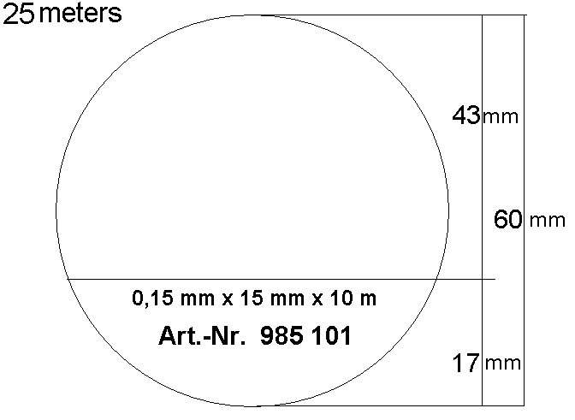
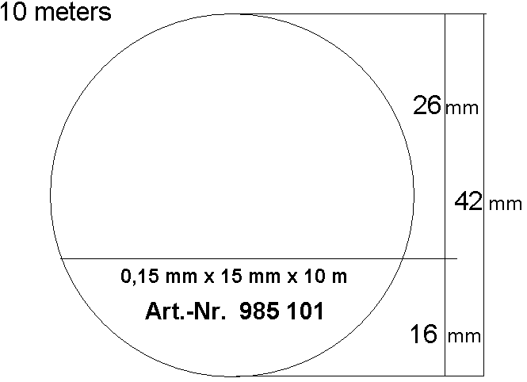

Empty label layout (Roll)
To be filled with customer logo and description
To be filled with customer logo and description
Printed on each roll - bar code is available

